Slide 1



Communicating your science at holiday Dinners
Project Bridge x R-Ladies
November 12, 2024

Slide 2

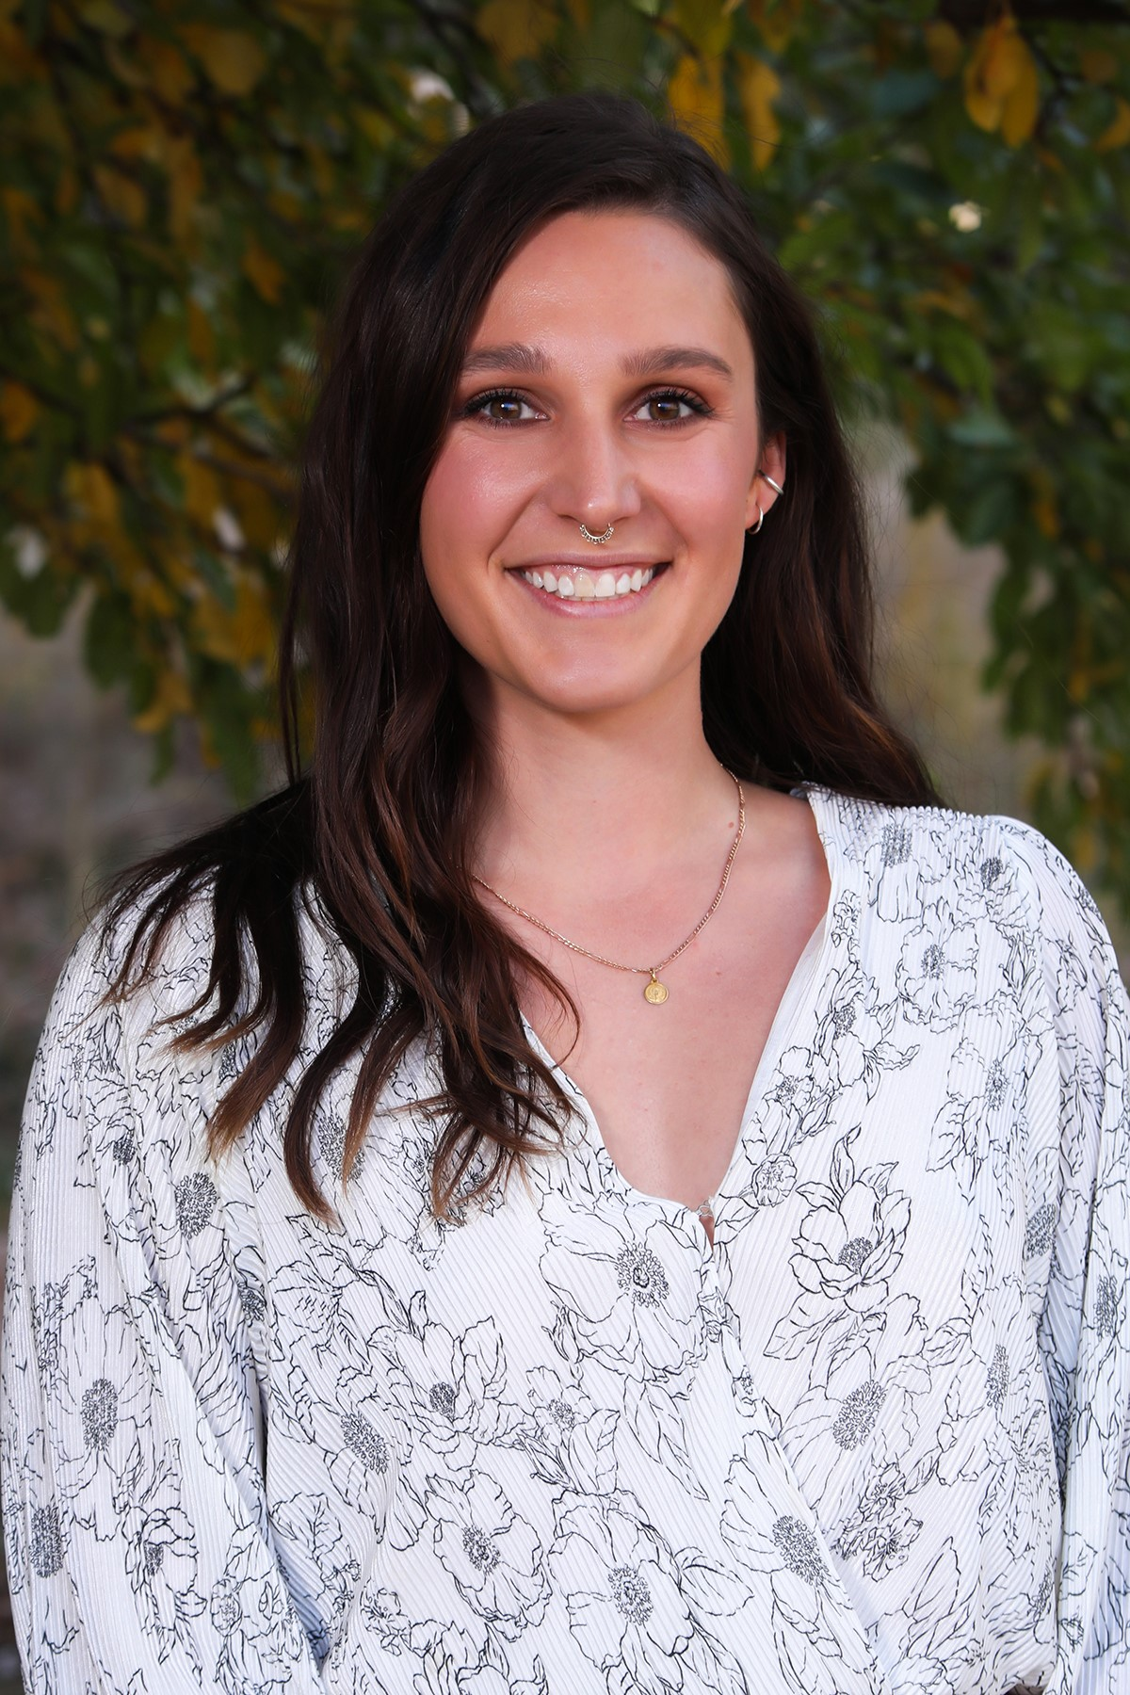
Rachael Natasia
3rd year MOLB student
van Dyk lab
Studies viruses
6th year MOLB student
Vögeli lab
Studies protein structure and function

Slide 3
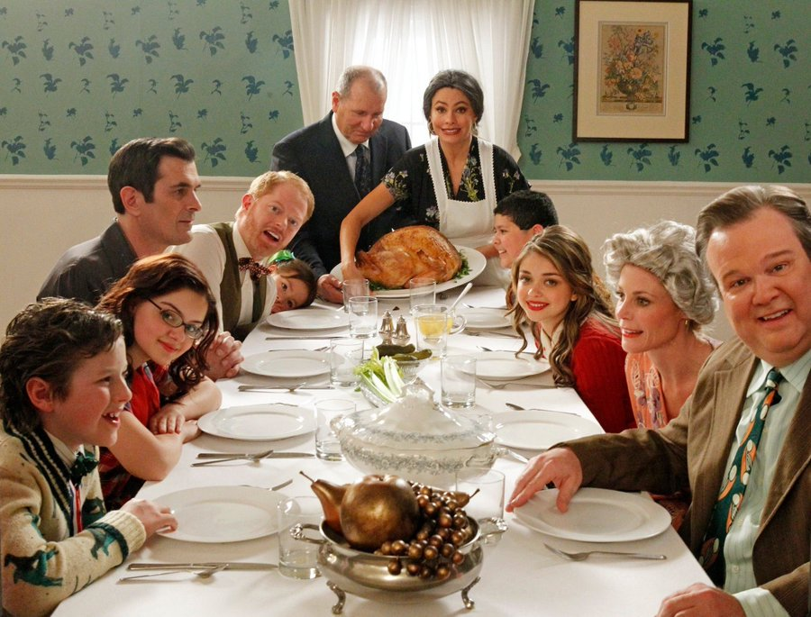
Tips and tricks
Who is your “audience”?
Notes:
1. Are you talking to adults? High school students? Children? Tailor your conversation based on what they might already know.

Slide 4

Tips and tricks
Who is your “audience”?
Use clear and simple language
Notes:
2. Try to use analogies and metaphors.

Slide 5
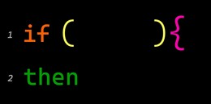
Tips and tricks
Who is your “audience”?
Use clear and simple language
Why does your research matter?
Notes:
3. If your research was successful, what is the potential big picture impact? Explain this in a way that is simple, and that your audience can relate to or understand.

Slide 6

Tips and tricks
Who is your “audience”?
Use clear and simple language
Why does your research matter?
Make it a conversation
Notes:
4. Allow people to ask you questions. This is a gauge to see if they actually understand what you are explaining, or it can be used as a way to pivot and try to explain where the misunderstanding is coming from

Slide 7

Tips and tricks
Who is your “audience”?
Use clear and simple language
Why does your research matter?
Make it a conversation
Less is more
Notes:
5. Focus on the big picture. It is difficult to explain what you do in great detail without jargon, start with a 10,000 foot view. What are the most important aspects or highlights? Keep it brief and fun.

Slide 8
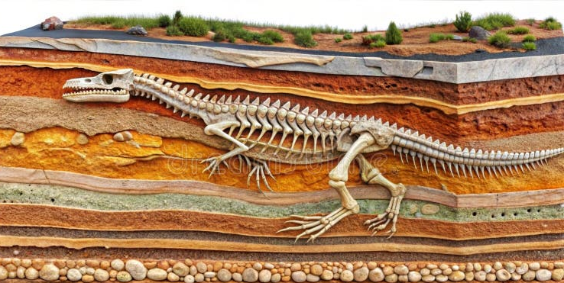
Tips and tricks
Who is your “audience”?
Use clear and simple language
Why does your research matter?
Make it a conversation
Less is more
Make adjustments
Notes:
6. If they seem to really be interested, dive a little deeper. It is like digging a hole.

Slide 9
Rachael’s Research
Gammaherpesviruses are DNA tumor viruses which include Epstein-Barr virus and Kaposi’s Sarcoma Associated herpesvirus. Virus infection originates at mucosal surfaces, followed by infection of macrophages, ending in B cells where the virus becomes latent. Within macrophages, the virus can exhibit both lytic and latent infection, but it is unclear how this is possible and what regulates this infection decision fate. I hypothesize that type I and type II interferon signaling synergistically enforces and maintains latent infection, respectively.
Notes:
Jargon

Slide 10
Rachael’s Research
Gammaherpesviruses are DNA tumor viruses which include Epstein-Barr virus and Kaposi’s Sarcoma Associated herpesvirus. Virus infection originates at mucosal surfaces, followed by infection of macrophages, ending in B cells where the virus becomes latent. Within macrophages, the virus can exhibit both lytic and latent infection, but it is unclear how this is possible and what regulates this infection decision fate. I hypothesize that type I and type II interferon signaling synergistically enforces and maintains latent infection, respectively.
Notes:
Flaws

Slide 11
Rachael’s Research
There are 3 types of herpesviruses. The most well-known is the family of herpesvirus that causes chicken pox, shingles, and oral and genital herpes. The second kind is not as well known but can cause an illness in children caused roseola. The third family is what I study; it can cause cancer. The virus first infects the body through surfaces like the mouth or nose, then spreads to a special kind of immune system cell called macrophages, and finally ends up in another type of immune cell called B cells, where the virus goes to sleep. In macrophages, the virus can either make more copies of itself or go to sleep, but we don’t understand how it makes this choice. I believe that the immune system sends out specific signals that helps the virus decide to stay asleep.
Notes:
Corrected

Slide 12
Rachael’s Research
There are 3 types of herpesviruses, the most well-known is the family of herpesvirus that causes chicken pox, shingles, and oral and genital herpes. The second kind is not as well known but can cause an illness in children caused roseola. The third family is what I study; they can cause cancer. When someone gets infected with any of these types of herpesviruses, the virus gets inside of your cells and makes more copies of itself. Eventually, your immune system will control this infection, and the virus will “go to sleep” inside of your cells. However, when you have a weakened immune system, this virus can wake back up and start making copies of itself again. The difference between these virus families is the type of cell in your body that it goes to sleep in. I am trying to figure out what specific part of the immune system causes the switch between the virus going to sleep and waking up, and if we can control this.
Notes:
Corrected

Slide 13
Natasia’s Research
Notes:
Jargon

Slide 14
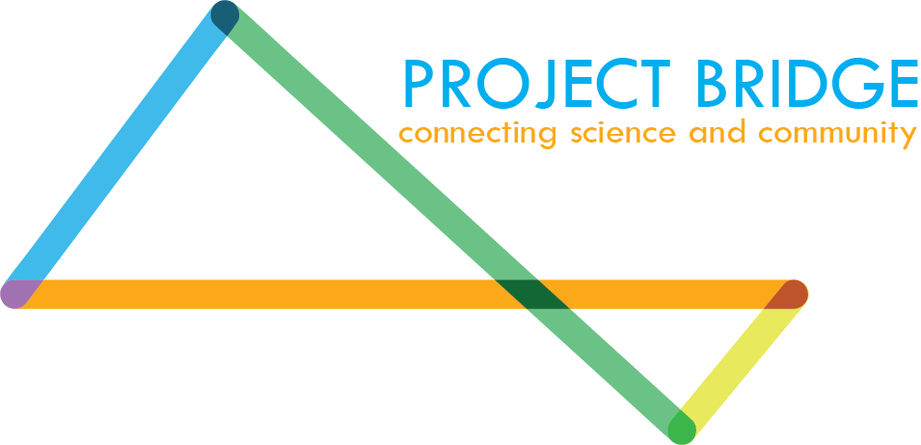



Thank you!!
Project Bridge Organization Website
Sign up for our email list!!
Project Bridge Colorado Website
Follow us on Instagram and X: @ProjBridgeCo
Notes:
Jargon

